Slide 1


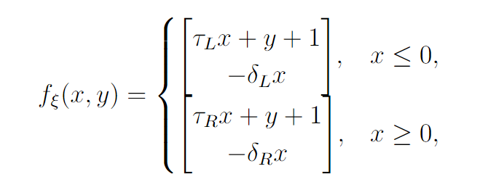
Demystifying Robust Chaos
- Indranil Ghosh

